Slide 1
Hackathon for Field Mapping Task-Splitting Algorithm
Team: “The Amigos”
Pragati Dhakal
SaDiksha Adhikari
Bishal Khatri
Nishan Dahal
Amrit kumar ARYAL

Slide 2
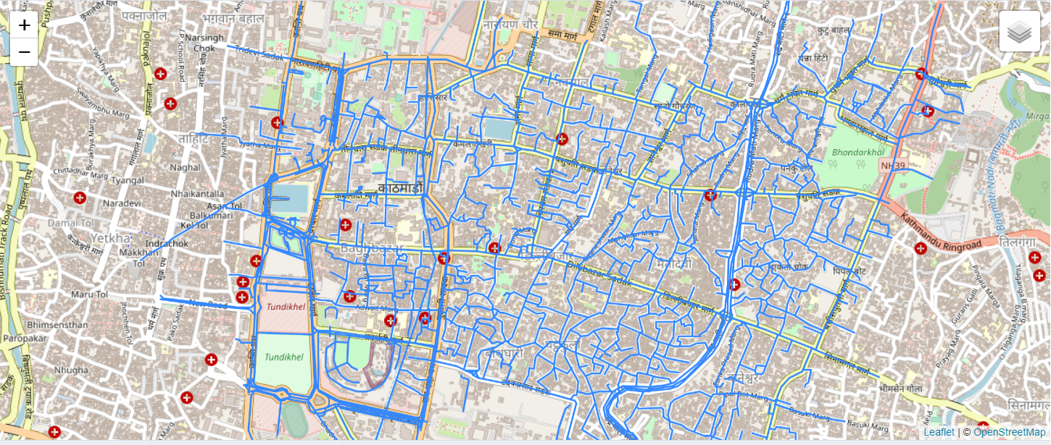
Prime Idea:
Split task on the basis of highway, riverways and density of buildings
Fig: Lines geometry of inslington_lines table

Slide 3
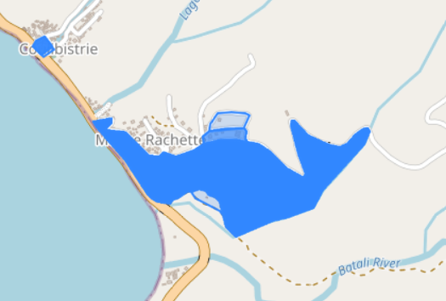
Problems Encountered:
Other polygons also given building attribute
Overlapped polygon features
Fig: Overlapped features

Slide 4
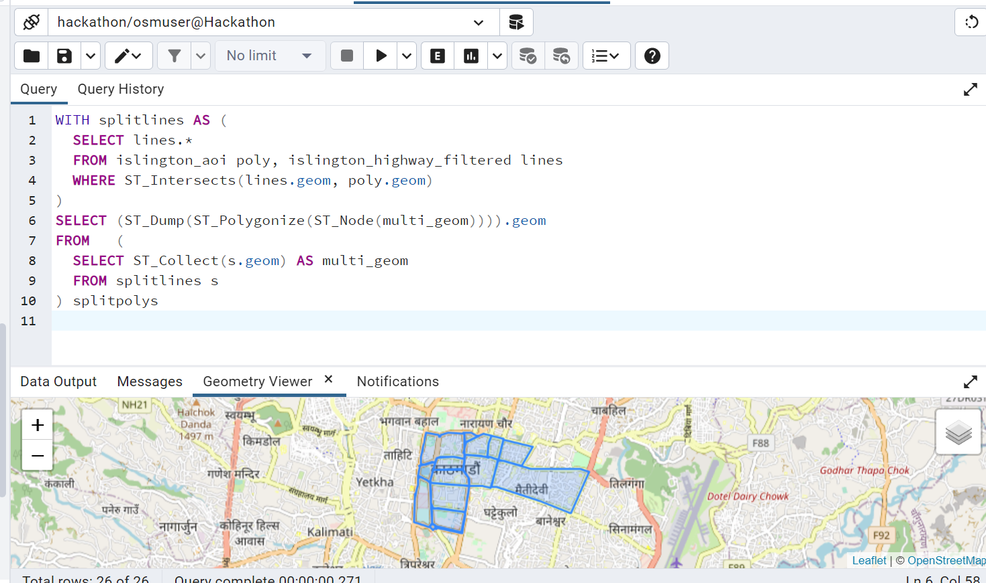
What is completed till now
Fig: Splitting task only on the basis of highway

Slide 5
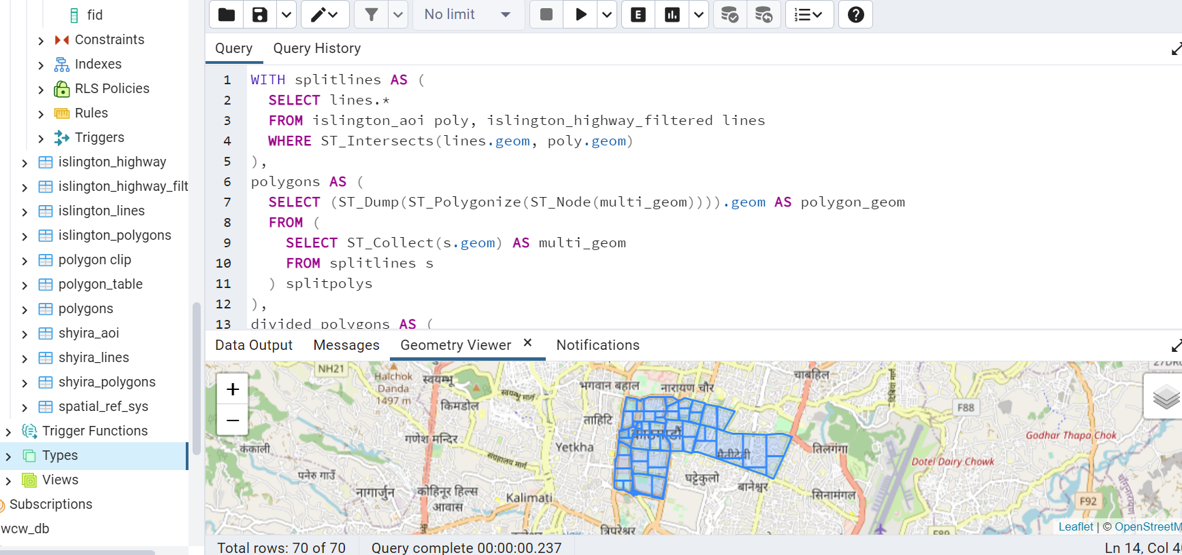
Fig: Splitting task with highways and equal number of buildings in each area

